Slide 1
Project Title
HAND GESTURE RECOGNITION WITH PYTHON OPENCV

Slide 2
Content
Problem definition
Project Title
Aim and Objectives
Expected Outcome

Slide 3
Indentified Problem
With the development of ubiquitous computing, the current user interaction
approaches with keyboard, mouse, and pen are not sufficient.
Direct use of hands can be used as an input device for providing natural interaction.

Slide 4
Aim and Objective
Aim – To, read, and interpret hand movements as commands.
Objectives-
To create a system that recognize the hand gesture by using python opencv.
The objective of this project is to create a complete system to detect, recognize and interpret hand gestures through computer vision.

Slide 5
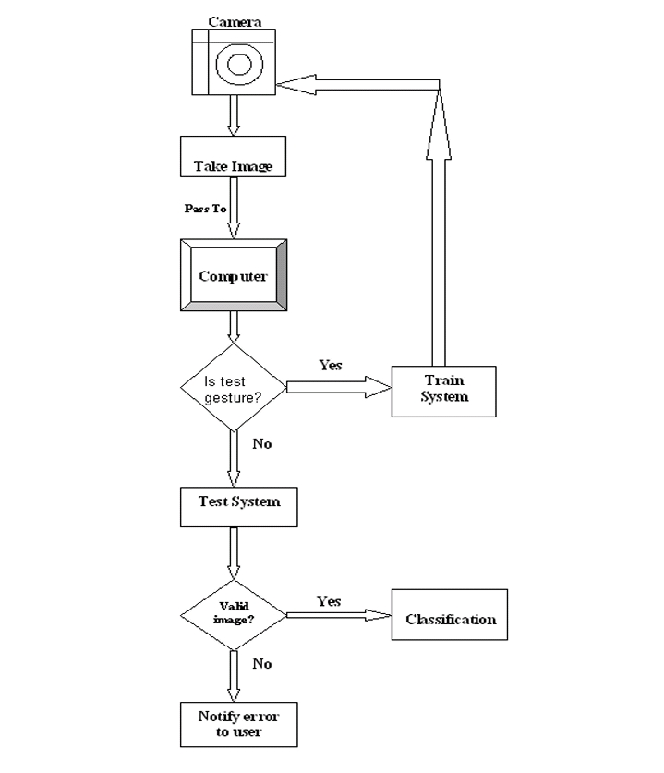

Slide 6
Expected Outcome of Project
To recognize hand movement and gesture and interpret it to natural language.
The scope of this project is to build a real-time gesture classification system that can automatically detect gestures in natural lighting conditions.
In order to accomplish this objective, a real-time gesture-based system is developed to identify gestures. This system will work as one of the futuristic of Artificial Intelligence and computer
vision with the user interface.
It creates a method to recognize hand gestures based on different parameters.
Priority of this system is to be simple, easy, and user-friendly Without making any special hardware. All computation will occur on a single PC or workstation. Only special hardware will use to digitize the image (Digital Camera)

Slide 7
USE :-
SIGN LANGUAGE RECOGNITION
ROBOT CONTROL
GRAPHIC EDITOR CONTROL
NUMBERS RECOGNITION
TELEVISION CONTROL

Slide 8
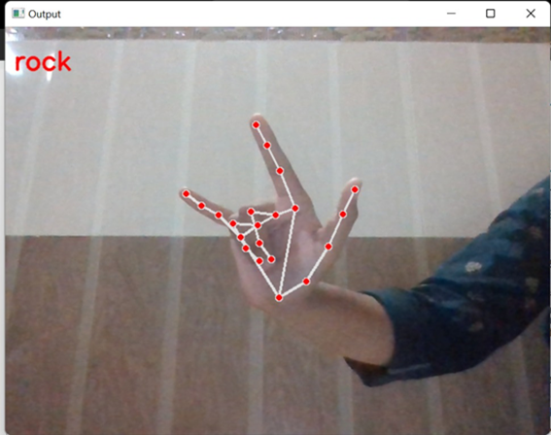
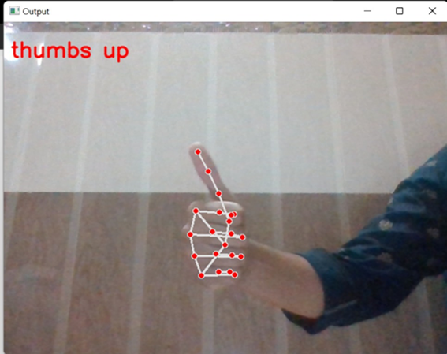
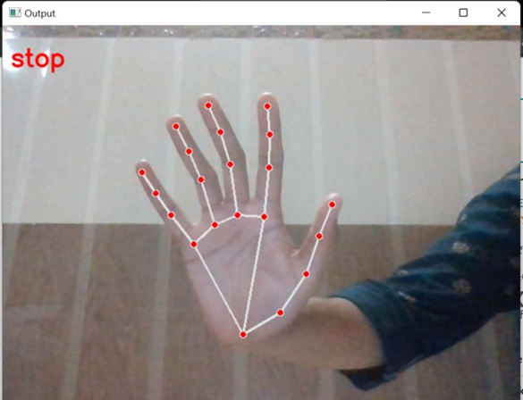
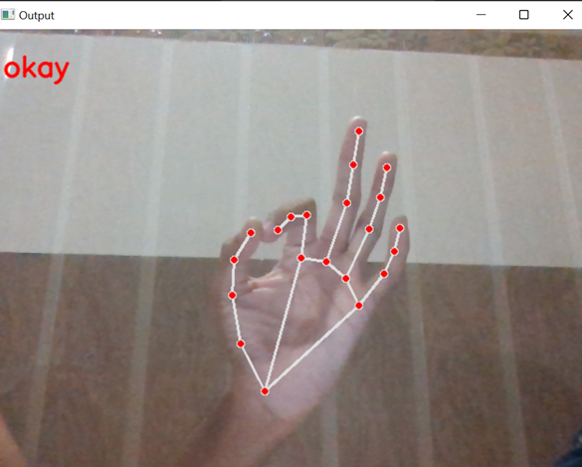
OUTPUT -

Slide 9
THANK YOU !!

